Slide 1
Health risks of cyanobacterial toxins in surface waters
Barbara Kubickova, M.Sc.
Supervision: assoc. Prof. Klára Hilscherová
NOTE: There are interactive elements on this poster. For an optimal view, please open the poster as a slideshow (i.e. in full-screen mode). you should click on the next to images/graphics in the sub-topic to learn more about what is shown. The details will disappear when you click the “?” again.
?
Aims
Hazard assessment of cyanobacterial metabolites towards:
The lungs and respiratory tract
The gastrointestinal tract and innate immune system
The development of the nervous system
Risk assessment for selected scenarios based on the characterized hazards
For more information on the following, please click the respective icons or boxes below. To return to this View, click the home button in the top right corner.
(Developmental) Neurotoxicity & Endocrine disruption
Highlights
Cyanobacterial toxins pose a hazard to human airways
Single-toxin toxicities are not representative of the effects observed with the blooms. Mixtures of cyanobacterial and bacterial metabolites, as well as anthropogenic pollutants present in water bodies may contribute to the observed effects
Low-dose and longer-term effects need to be taken into account, especially with regard to drinking water safety
Retinoid-like activity observed in cyanobacterial blooms and co-occurrence with neurotoxins will be further investigated
A state-of-the-art in vitro model to assess of retinoids towards humans neurodevelopmental effects
Cyanobacterial blooms, bioactive metabolites, and toxins
The Lungs
Gastrointestinal tract & mucosal immune system
Conclusions
This project has received funding from the European Union’s Horizon 2020 research and innovation programme under the Marie Sklodowska-Curie grant agreement No. 722493.
This poster only presents the author’s views and the Research Executive Agency is not responsible for any use that may be made of the information it contains.

Slide 2
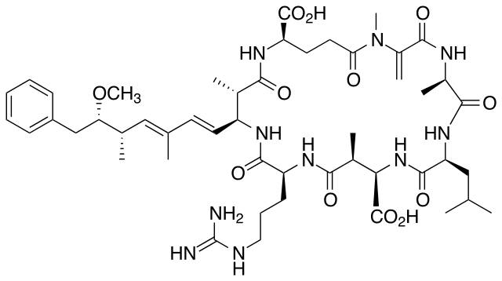
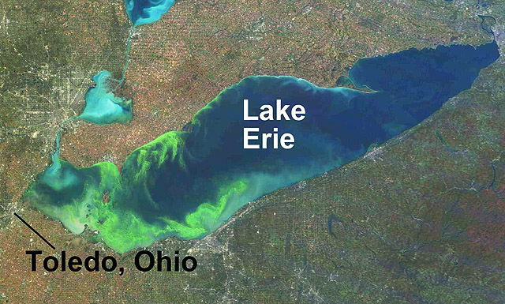
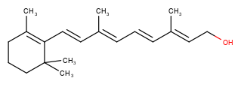
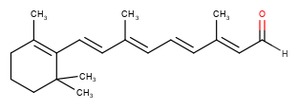
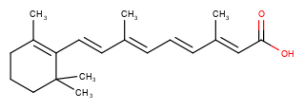
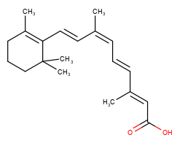
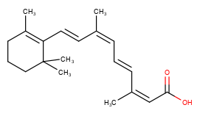
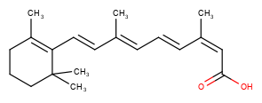
?
?
?
?
Cyanobacterial bloom in the Baltic Sea, July 2010
Cylindrospermopsin (CYN)
Microcystin-LR (MCLR)
All-trans retinoic acid (atRA)
Cylindrospermopsin (CYN)
Cyanobacterial blooms
Retinoids
Microcystins
Microcystins are cyclic heptapeptides; currently the class comprises more than 270 congeners, that differ by incorporation of different amino acids at positions 2 and 4
The most frequently detected congener is microcystin-LR with leucine (L) in position 2 and arginine (R) in position 4
Inhibiting cellular protein phosphatase 1 and 2a, affecting particularly the liver due to the high metabolic and enzymatic activity in hepatocytes
Show tumour promoting activity
They can penetrate through the blood-brain barrier and have been detected in brain tissue upon exposure
Microcystins are the cyanobacterial toxins most frequenty connected to cases of human exposure (incl. fatalities), responsible for e.g. the Caruaru accident in a dialysis clinic or the Toledo Water crisis (summarized on the right)
Toledo water crisis – 2014
2 August, 2014
2 days
400,000 people without safe drinking water
Affected:
Washing hands
Showering
Filling bowls for pets
Drinking water
https://greatlakes.org/2019/08/five-years-later-lessons-from-the-toledo-water-crisis/
https://www.mbari.org/environmental-sample-processor-monitors-drinking-water-lake-erie/
https://www.circleofblue.org/2015/great-lakes/the-toledo-water-crisis-one-year-later/
Are events of massive proliferation of cyanobacteria (“blue-green algae”)
Are photosynthetic prokaryotes, therefore their growth is not limited by bioavailable carbon, organic energy sources. Therefore, the main growth limiting nutrients are phosphate and nitrogen
Are enhanced by human action – anthropogenic eutrophication – due to increased nutrient input into watersheds
Occur more often in waterbodies that are recipients of waters rich in xenobiotic substances, adding to the mixture of bioactive contaminants.
Factors contributing to/ enhancing cyanobacterial blooms:
Climate change
Agricultural inputs
Fertilizers (NO₃, NO₂, NH₄, PO₄)
Challenges for water catchment management:
Reduce impact of agricultural sources
Bloom mitigation strategies
Monitoring of ecosystem resilience and effects
Retinoids are small organic isoprenoid-derived molecules
They are produced ubiquitously in nature by photosynthetic organisms, including plants and cyanobacteria
Retinoids are essential for development, but have teratogenic properties at higher concentrations
In the environment, cyanobacterial retinoids have been linked to malformations in fish and frogs
Effects observed affected particularly the (developing) nervous system, but retinoid signaling is involved in reproduction (e.g. spermatogenesis) and neuropathologies like affective disorders and dementia
Retinoid signalling, conducted via retinoic acid receptor (RAR) and retinoid X receptors (RXR) heterodimers is a candidate pathway for endocrine disruption
Invasive species: Formerly considered as limited to tropical habitats, CYN is recently detected more often in temperate climates, posing a hazard to drinking water safety
The cyanobacterial toxin cylindrospermopsin (CYN) is detected in the environment with increasing frequency, driving scientific effort to asses emerging health risks from CYN producing blooms
Exposure to CYN occurs predominantly orally, resulting in hepatotoxicity. Nevertheless, extrahepatic manifestations of toxicity have been reported. Furthermore, cyanobacterial toxins have been detected in aerosols and dust particles, suggesting potential toxic effects in the respiratory tract
Blooming water
(Cyanobacteria produce and release metabolites and toxins to water)
temperate
β-carotene
all-trans retinol (Vitamin A)
all-trans retinal
all-trans retinoic acid
tropic
Concerns related to cyanobacterial toxins & metabolites in the aquatic environment:
Toxicity to aquatic organisms
(Bio)accumulation in fish for consumption (e.g. sports-fishing for trout)
Drinking water safety?
Drinking water abstraction point
9-cis retinoic acid
9,13-di-cis retinoic acid
13-cis retinoic acid

Slide 3
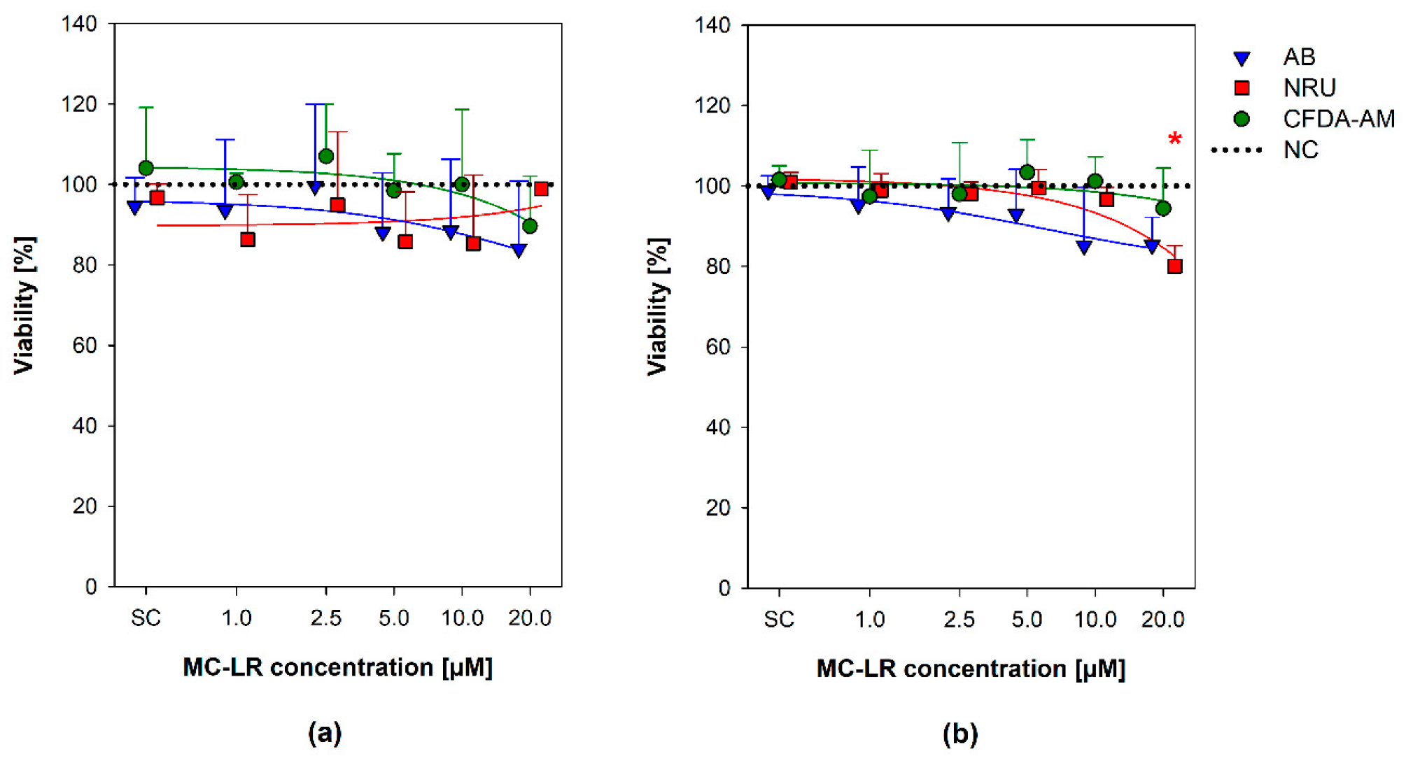
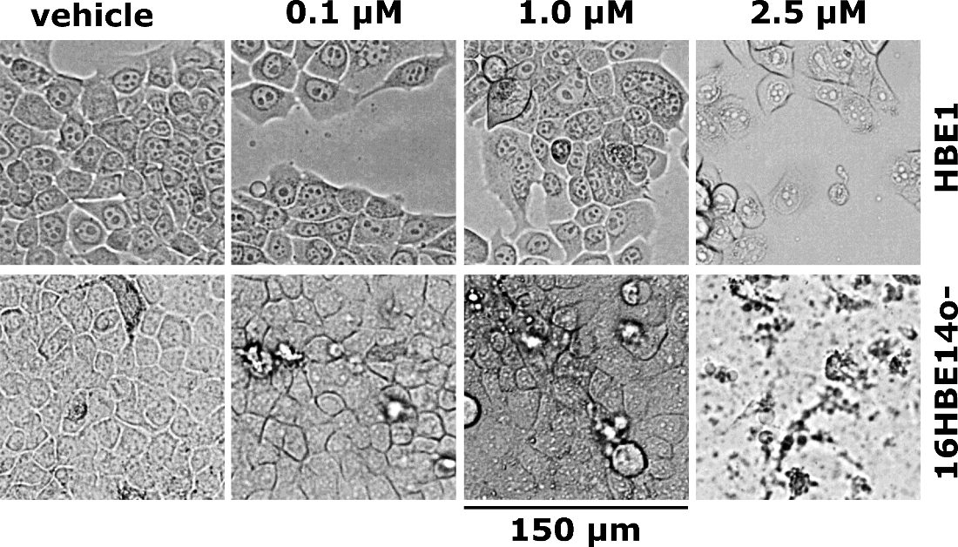
Cylindrospermopsin (CYN)
Altered cell morphology
Cytotoxicity
Altered cell signalling
Microcystin-LR (MCLR)
confirmed cellular uptake of MCLR
No Cytotoxicity
Cell signalling unchanged
Effects on human airway epithelia assessed in vitro upon exposure to:
Cylindrospermopsin (CYN)
Microcystin-LR (MCLR)
Cytotoxicity & altered cell morphology with ≥ 1 µM CYN
No cytotoxicity upon MCLR exposure
control
0.1 µM
1.0 µM
2.5 µM
?
control
HBE1
16HBE14o-
0.05 1 2 8 24 48
time [h]
1 8 24 48
?
ERK 1/2
HBE1
P-ERK 1/2
1 µM CYN
p38
150 µm
P-p38
16BE14o-
GAPDH
HBE1
16HBE14o-
Western blot detection of MAPK ERK1/2 and p38 phosphorylation (P-) after exposure to 1 µM CYN. Distinct changes (increase) in phosphorylation after 24-48 h are highlighted with red boxes. One representative blot of four experiments is shown.
Immunodetection of intracellular MCLR-protein adducts
Cytotoxic effects, morphological alterations and cell layer destruction (↑) upon 24 h CYN exposure were observed in both airway epithelial cell lines. Accordingly, cell viability decreased in a dose-dependent fashion in all three metabolic assays (↓).
Mean ± SD, n=3, *: p≤0.05, **: p≤0.01, ***: p≤0.001. FOC: fraction of control, relative to naïve (untreated) control.
A combination of three metabolic assays was adopted to assess the viability upon exposure to 1, 2.5, 5, 10, and 20 µM MC-LR for 48 h. Values are plotted as a percentage of viability in comparison with the untreated control (dotted line). The scatter plot represents mean + S.D. from independent experiments (n ≥ 3) conducted in triplicate. Asterisks (*) indicate values significantly different from the negative control (ANOVA followed by Dunnett’s post-hoc test, p ˂ 0.05). SC, solvent control; CFDA-AM, 5-carboxyfluorescein diacetate acetoxymethyl ester; AB, Alamar blue®; NRU, neutral red uptake; NC, negative control.
Altered cell signalling
1 µM MCLR
solvent
1 µM MCLR
solvent
1
8
24
48
NC
1
8
24
48
1
8
24
48
NC
1
8
24
48 h
Stress, Inflammation, Apoptosis
Overview of the investigated MAP kinase pathways. Phosphorylation of p38 has been linked to cell stress, inflammation and apoptosis. p38 kinase substrates include the transcription factor p53 (pro-apoptotic activity, tumor suppressor, cell cycle arrest at G1/S). Phosphorylation of MAPK ERK1/2 is linked to cell proliferation, differentiation and survival. Active ERK1/2 amongst others promotes nuclear translocation of the proto-oncogene c-Fos upon phosphorylation⁹.
60 kDa
?
?
37 kDa
16HBE14o-
30 kDa
HBE1
Immunodetection of putative MCLR protein adducts in bronchial cell lines upon exposure to 1 µM MC-LR for 1, 8, 24, and 48 h. MC-LR protein adducts were detected using the primary anti-MC-LR antibody (MC10E7; Alexis, Switzerland). Representative blots of independent experiments (n = 2) are shown. NC: negative control.
20 kDa
HBE1
GAPDH
16HBE14o-
Proliferation, Cell cycle progression, tumor growth
Though taken up into bronchial cells, MCLR does not alter cell survival or MAP kinase signalling (data not shown).
Conclusions
Publications:
Kubickova, B, Laboha, P, Hildebrandt, J-P, Hilscherova, K, Babica, P: Effects of cylindrospermopsin on cultured immortalized human airway epithelial cells. Chemosphere 2020, 220(4), 620-628; https://doi.org/10.1016/j.chemosphere.2018.12.157
Brozman, O, Kubickova, B, Babica, P, Laboha, P: Microcystin-LR Does Not Alter Cell Survival and Intracellular Signaling in Human Bronchial Epithelial Cells. Toxins 2020, 12(3), 165; https://doi.org/10.3390/toxins12030165

Slide 4
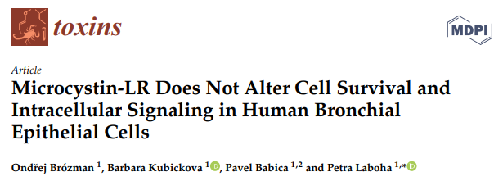
Effects on human airway epithelia assessed in vitro
Inhalation toxicity (completed)
There is a human health hazard of cyanobacterial/toxin inhalation
The respiratory tract is a potential target of CYN toxicity
Extended in vitro CYN-exposure, unlike MCLR-exposure, alters intercellular signalling via MAP kinases, particularly indicates inflammatory processes (p38 phosphorylation after ≥ 24 h
Exposure to CYN, not to MCLR, impairs the barrier function of airway epithelia in vitro
Toxic effects were investigated at environmentally relevant concentrations (≤ 1 µM)
control
0.05 1 2 8 24 48
time [h]
1 8 24 48
ERK 1/2
P-ERK 1/2
1 µM CYN
p38
P-p38
GAPDH
HBE1
16HBE14o-
Western blot detection of MAPK ERK1/2 and p38 phosphorylation (P-) after exposure to 1 µM CYN. Distinct changes (increase) in phosphorylation after 24-48 h are highlighted with red boxes. One representative blot of four experiments is shown.
Back to results
Publications:
Kubickova, B, Laboha, P, Hildebrandt, J-P, Hilscherova, K, Babica, P: Effects of cylindrospermopsin on cultured immortalized human airway epithelial cells. Chemosphere 2020, 220(4), 620-628; https://doi.org/10.1016/j.chemosphere.2018.12.157
Brozman, O, Kubickova, B, Babica, P, Laboha, P: Microcystin-LR Does Not Alter Cell Survival and Intracellular Signaling in Human Bronchial Epithelial Cells. Toxins 2020, 12(3), 165; https://doi.org/10.3390/toxins12030165

Slide 5
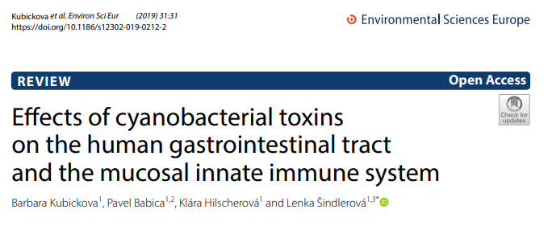
Gastrointestinal tract & mucosal immune system
For cyanobacterial bloom-associated metabolites & toxins:
Oral exposure is the most relevant route
Gastrointestinal symptoms are the most frequently reported symtoms
The gastrointestinal epithelia are the first to be overcome for systemic toxicity
Still, susceptibility of the gastrointestinal tract remains underinvestigated
Examples are depicted below.
Data gaps
Lack of data regarding entero- and immunetoxicity, esp. For toxins other than MCs & CYN
Re-evaluation of CYN & MCs regarding their enterotoxicity
Complex natural mixtures of blooms cannot be evaluated on a single-toxin basis; mixture effects need to be accounted for
Cylindrospermopsin (CYN)
Stomach ulcers
Bleeding in stomach & small intestine
Impaired mucosal phagocytosis
Activation of macrophages
Decreased lymphocyte proliferation
Microcystins (MCs)
Lesions of small intestine & surface erosion
Colonic DNA damage & increased apoptotic indices along the intestine
Neoplastic transformation → colon cancer
Impaired mucosal immunity
Secretion of pro-inflammatory cytokines (IL-6, IL-8) & oxidative stress (in vitro)
Cyanobacterial Lipopolycaccharides (LPS)
Irritant to the gastrointestinal tract, other mucosa, & skin
Inflammatory properties vary from lethal toxicity (septic shock) to anti-inflammation (selective antagonist to eubacterial LPS)
Relevance towards gastrointestinal inflammation needs further investigation
Conclusions
Publication:
Kubickova, B, Babica, P, Hilscherova, K, Sindlerova, L: Effects of cyanobacterial toxins on the human gastrointestinal tract and the mucosal innate immune system. Environmental Sciences Europe 2019, 31; https://doi.org/10.1186/s12302-019-0212-2

Slide 6
Gastrointestinal tract & mucosal immune system (completed)
Data gaps
Lack of data regarding entero- and immunetoxicity, esp. For toxins other than MCs & CYN
Re-evaluation of CYN & MCs regarding their enterotoxicity
Complex natural mixtures of blooms cannot be evaluated on a single-toxin basis; mixture effects need to be accounted for
The information available on distinct gastro-intestinal effects is limited and needs further investigation
CYN and MCLR should be re-assessed regarding their enterotoxicity
Data from advanced in vitro models needed for accurate hazard characterization
Toxicity assessment of novel toxins & metabolites needed
Characterization of (non-)toxic bloom metabolome to characterize hazards of co-exposure
Safe drinking Water: Low toxin concentrations need to be toxicologically covered
Back to Results
Publication:
Kubickova, B, Babica, P, Hilscherova, K, Sindlerova, L: Effects of cyanobacterial toxins on the human gastrointestinal tract and the mucosal innate immune system. Environmental Sciences Europe 2019, 31; https://doi.org/10.1186/s12302-019-0212-2

Slide 7
(Developmental) Neurotoxicity, retinoid signalling, & endocrine disruption
Neural differentiation
After 4 d of attachment cells were exposed for 18 d to: (medium exchange every 3 d; in neutral medium if not stated differently)
8-1000 nM all-trans retinoic acid
Solvent control: 0.004 % methanol in neutral medium
Endpoints: Immunocytochemistry and western blot for biomarkers of neural differentiation
Samples were collected at DIV4 and DIV13 for western blot and qPCR analysis and DIV22 for western blot, qPCR, and immunocytochemistry.
Medium variants
Neutral medium (naive): 0.5x ZellShield, 1x GlutaMax, 1x MEM non-essential amino acids, 0.5x N2 supplement, 0.5x B-27 supplement. All manufactured by Gibco and added to DMEM/F12 (1:1) medium.
NSC-medium (non-differentiated control): neutral medium + bFGF (20 ng/mL)
Differentiation medium: neutral med. + BDNF (20 ng/mL) + GDNF (20 ng/mL)
14
22
days in vitro (DIV) (in pink: sampling days)
?
0
4
7
13
Human Neural Stem Cells (hNSC)
Neurons + glia
neural differentiation (4 days attachment + 18 days exposure)
Acute Toxicity (96 h)
Solvent control
differentiated
Biomarker expression (DIV22) RA decreases the maturation of neurons within the therapeutic window of RA.
atRA 1000 nM
atRA 200 nM
DIV5 non diff
(Data not shown)
non diff
atRA 40 nM
?
Objectives:
Model validation for human (developmental) neurotoxicity testing
Single compound & mixture toxicity assessment
naive
atRA 8 nM
Committed neurons
Tuj1
Mature neurons
MAP2
Dopaminergic neurons
TH
Retinoic acid (RA) signalling interference
Exposure to RA decreases the degree of network patterning in the differentiating culture.
While therapeutic concentrations (1 µM atRA) diminish the degree of structure to almost non-differentiated conditions, physiological (i.e. non-teratogenic in pregnant women) concentrations of 8 nM atRA (data not shown) show a pattern comparable to the solvent or growth factor-differentiated control.
Molecular crosstalk via RXR:
The fact, that RXR is the universal heterodimerization partner for all Type-II nuclear receptors allows for molecular crosstalk. This has been proven e.g. for thyroid hormone receptor (TR): (co-)exposure to retinoids augments the thyroid hormone-related response in the Xenopus eleutheroembryo assay (OECD TG 248, 2019) and retinoids alter TR response in vitro (Paul-Friedman et al., 2019. DOI: 10.1289/EHP5314).
Endocrine disruption potential:
Besides the designated retinoid receptors (RAR & RXR), the synthesizing enzymes (alcohol, retinol and, crucially, retinal dehydrogenases) and metabolizing enzymes (i.e. cytochrome P450 monooxygenase family 26) are critical for regulating the correct spatio-temporal distribution of active retinoids.
Additionally, environmental pollutants like organotin compounds, flame retardants (e.g. PBDE), and dioxins have been reported to interfere with retinoid signalling (review in preparation).
(Astro)glial cells
GFAP
Non-permissive heterodimers
Primary function: hormone receptors
Permissive heterodimers
Response to dietary lipids (e.g. fatty acids, steroids) and xenobiotics
nestin
Neural stem cells
FXR
β-actin
Universal hetero-dimerization partner
LXR
Network patterning decreased by RA
RARs
PPAR
Non-differentiated (+bFGF)
Differentiated (+BDNF/GDNF)
Solvent Control (0.004% MeOH)
All-trans retinoic acid
Physiological serum levels of RA in pregnant women: ≈ 8 nM
Therapeutic RA serum levels: up to 1 µM (treatment for acne or cancer)
Biomarkers altered upon 18 d retinoic acid (RA) exposure (DIV22): (preliminary results)
RA exposure does not alter the baseline population of neural stem cells beyond unexposed levels
RA dose-dependently decrease neural maturation (MAP2), particularly into the dopaminergic lineage (TH) within the therapeutic range of retinoic acid, while inducing these processes at physiological levels
High concentrations (1 µM) of RA abolish differentiation into astroglial cells (GFAP)
TR
RXR
CAR
40 nM
200 nM
1000 nM
Nucleus
Tubulin βIII
Synaptophysin
?
?
VDR
PXR
…
Allows for molecular crosstalk to other signalling pathways! (e.g. thyroid signalling)
Nucleus
Nestin
Tyrosin hydroxylase
Conclusions
Anticipated publications:
Kubickova, B, Ramwell, C, Hilscherova, K, Jacobs, MN: Developing risk assessment approaches of unregulated Endocrine Active Substances in surface waters: retinoids as a European case study. (under preparation, expected autumn 2020)
Kubickova, B, Martinkova, S, Bohaciakova, D, Hilscherova, K: Naturally occurring retinoids alter differentiation of human Neural Stem Cells in vitro. (under preparation, expected summer 2020 )
Dose-dependend decrease in network formation!

Slide 8
(Developmental) Neurotoxicity, retinoid signalling, & endocrine disruption (in progress)
A human health-relevant developmental neurotoxicity in vitro model, in line with the requirements of international consortia (e.g. JRC, ECVAM) was successfully adopted and implemented
The model shows dose-dependent response to model retinoid compounds (all-trans retinoic acid); supporting the validity of the results
Retinoid exposure affects mainly neural maturation (MAP2 and TH biomarkers) and network patterning.
While physiological concentrations stimulate the functional differentiation beyond levels induced by growth factors, therapeutic elevated retinoid levels pronouncedly decrease or even abolish these processes
Implications of retinoid signalling interference should be regarded beyond development and include neurological disease like dementia
Mixtures of retinoids together with other cyanobacterial metabolites, but also co-occurring anthropogenic pollutants and naturally occurring compounds need to be assessed
Retinoid signalling is a candidate pathway for endocrine disruption currently under evaluation by the OECD
Water legislation should include point-of extraction effect-based criteria also for endpoints of endocrine activity.
Back to Results
Anticipated publications:
Kubickova, B, Ramwell, C, Hilscherova, K, Jacobs, MN: Developing risk assessment approaches of unregulated Endocrine Active Substances in surface waters: retinoids as a European case study. (under preparation, expected autumn 2020)
Kubickova, B, Martinkova, S, Bohaciakova, D, Hilscherova, K: Naturally occurring retinoids alter differentiation of human Neural Stem Cells in vitro. (under preparation, expected summer 2020 )

Slide 9
Conclusions
Inhalation toxicity (completed) | Gastrointestinal and immune toxicity (completed) | (developmental) neurotoxicity & retinoid signalling (in progress)
There is a human health hazard of cyanobacterial/toxin inhalation | The information available on distinct gastro-intestinal effects is limited and needs further investigation | A human health-relevant developmental neurotoxicity in vitro model, in line with the requirements of international consortia (e.g. JRC, ECVAM) was successfully implemented and is being validated
The respiratory tract is a potential target of CYN toxicity | CYN and MCLR should be re-assessed regarding their enterotoxicity | Retinoid exposure affects mainly neural maturation (MAP2 and TH biomarkers) and network patterning.
Extended in vitro CYN-exposure, unlike MCLR-exposure, alters intercellular signalling via MAP kinases, particularly indicates inflammatory processes (p38 phosphorylation after ≥ 24 h | Data from advanced in vitro models needed for accurate hazard characterization | While physiological concentrations stimulate the functional differentiation beyond levels induced by growth factors, therapeutic elevated retinoid levels pronouncedly decrease or even abolish these processes
Exposure to CYN, not to MCLR, impairs the barrier function of airway epithelia in vitro | Toxicity assessment of novel toxins & metabolites needed | Implications of retinoid signalling interference should be regarded beyond development and include neurological disease like dementia
Toxic effects were investigated at environmentally relevant concentrations (≤ 1 µM) | Characterization of (non-)toxic bloom metabolome to characterize hazards of co-exposure | Mixtures of retinoids together with other cyanobacterial metabolites, but also co-occurring anthropogenic pollutants and naturally occurring compounds need to be assessed
 | Safe drinking Water: Low toxin concentrations need to be toxicologically covered | Retinoid signalling is a candidate pathway for endocrine disruption currently under evaluation by the OECD
 |  | Water legislation should include point-of extraction effect-based criteria also for endpoints of endocrine activity.
Thesis expected autumn 2020

