Slide 1
RECETOX
For a healthy future

Slide 2
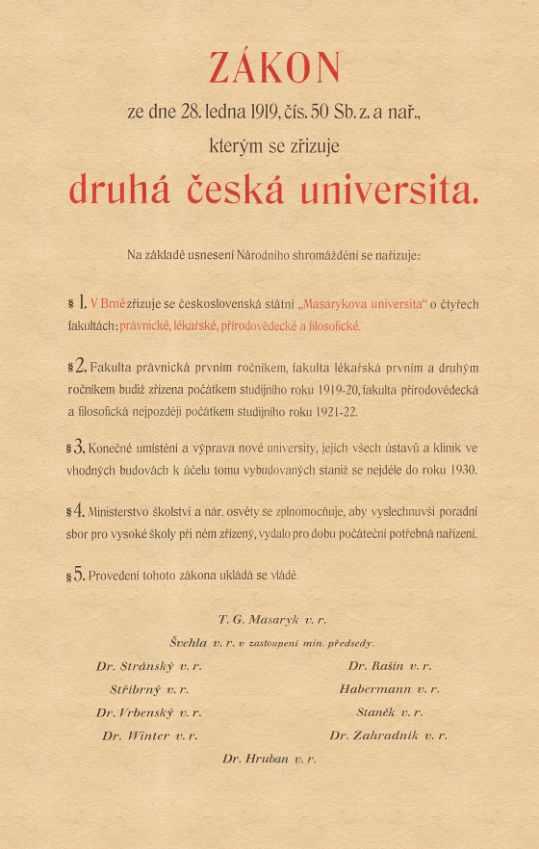
MUNI facts & figures

Slide 3
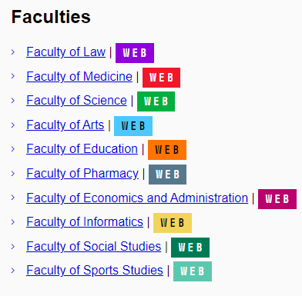
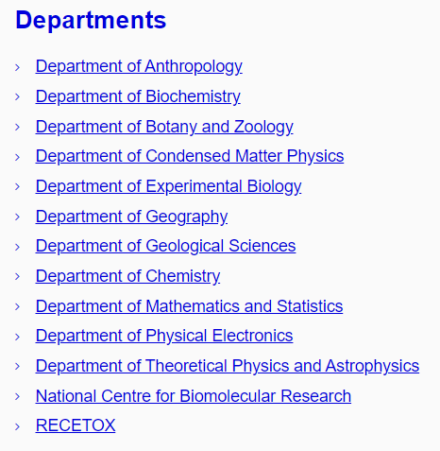
Masaryk University – RECETOX
Size and performance of RECETOX:
Larger than several Faculties of MUNI

Slide 5
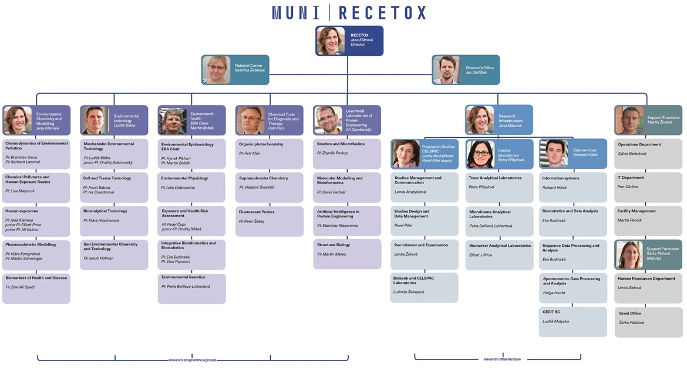
RECETOX - structure

Slide 6
RECETOX milestones
1983
Established at SCI MUNI as the “Department of Formation and Protection of the Environment”
2001
Partnerships with UNEP/UNIDO initiated (inventories of persistent chemicals on the regional & continental scale)
2006
National Centre for Persistent Organic Pollutants established at RECETOX based on agreement with Czech Ministry of Environment
2009
RECETOX endorsed as Stockholm Convention Regional Centre for Capacity Building and the Transfer of Technology
2010
New facilities build from the European Structural and Investment Funds. RECETOX Research Infrastructure is running in Open Access mode and included in Czech Roadmap of RIs
2012
ELSPAC cohort study relocated to RECETOX
2014
Trace Analytical Laboratories accredited and Global monitoring plan data warehouse developed based on GENASIS
2016
Three major EU projects acquired (HMB4EU, ERA-Planet, ICARUS)
2017
Two major ESIF projects granted
2018
Two study programmes accredited. Organization structure change. RECETOX biobank construction launched.
2019
Three H2020 projects enabling the further development of RECETOX granted
2020
TEAMING started. ERA Chair hired. The CELSPAC biobank construction finished.
2021
EIRENE project included in the ESFRI Roadmap 2021. 30th anniversary of the CELSPAC study.
2022
30th anniversary of the CELSPAC study. CELSPAC Biobank opening.
2023
40th anniversary of the RECETOX.

Slide 7
RECETOX in brief
RECETOX is a leading Czech research institute established at Masaryk university, which covers a broad range of basic and applied research on toxic compounds in the environment and their effect on human health.
RECETOX pillars:
Research activities
Education programmes
Open-Access Research Infrastructure
Science to Policy and Society platforms (National Centre for Toxic Compounds, Stockholm Convention Regional Centre for Capacity Building and the Transfer of Technology, WHO Collaboration Centre)
Application of research results (spin-off ENANTIS, collaborative & contractual research)

Slide 8
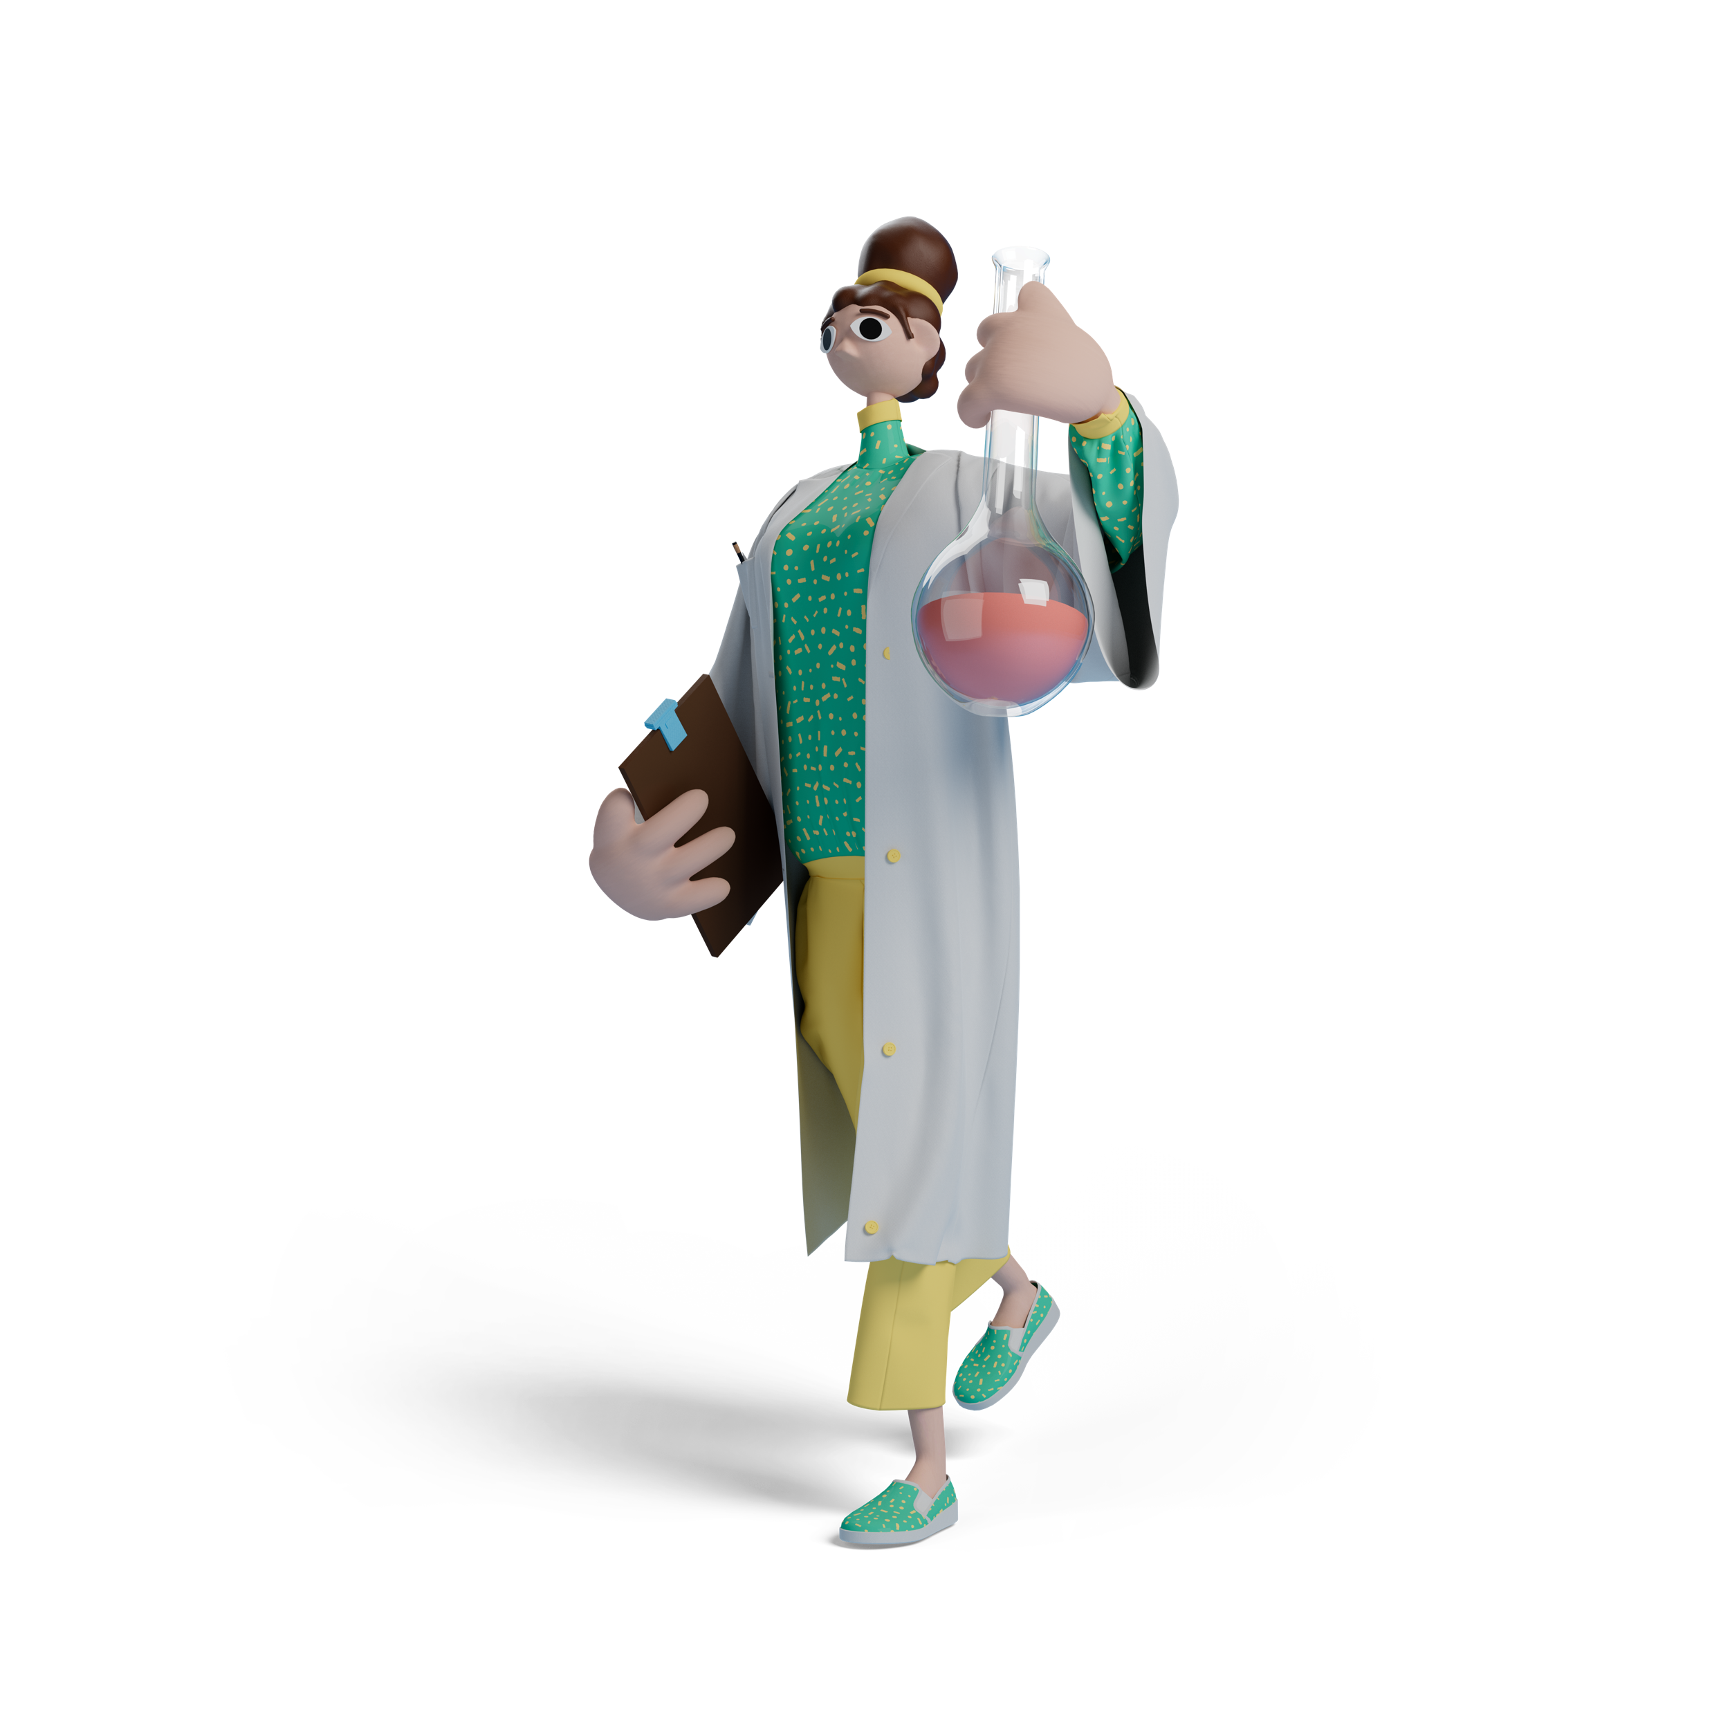
RESEARCH at RECETOX
RECETOX targets research and education in cross-cutting area of Environment and Health. Our high quality interdisciplinary research combines chemical, biological, environmental and epidemiological approaches supported by state of the art facilities.
Research Programmes
Environmental
Chemistry and
Modelling
Environmental
Toxicology
Environmental
Health
Chemical Tools
for Diagnosis
and Therapy
Loschmidt
Laboratories
of Protein Engineering
RECETOX Research Infrastructure
RECETOX
Laboratories
CELSPAC
Population studies
Data
services

Slide 9
RECETOX Research Infrastructure
The RECETOX Research Infrastructure (RI) is a single-sited research facility, which supports the implementation of interdisciplinary research projects and conducts
the analyses of a broad range of anthropogenic and natural toxins in environmental or biological matrices,
operation of long term environmental and population studies, and
development of complex software tools for management, analysis, interpretation, and visualization of available data.
Core Facilities of the RECETOX RI:
RECETOX Laboratories
CELSPAC Population studies
Data services
Core facilities and labs of the individual Research programmes.
The infrastructure is equipped with state-of-the-art facilities, possesses excellent expertise and provides access to facilities, services and training to the international research community, collaborators and other partners in the open-access mode.

Slide 10
EDUCATION
The RECETOX provides education in interesting disciplines that are on the cutting edge of scientific disciplines such as chemistry, biology, mathematics, statistics, or epidemiology.
Accredited educational programs:
Environment and Health (bachelor's and master's program)
Mathematical Biology and Biomedicine (bachelor's and master's program)
Environmental Health Sciences (doctoral programs).
Emphasize on development of theoretical knowledge, practical skills and applications of results.
Our students are involved in research projects and can take part in international internships at prestigious research institutes and universities in Europe and North America.

Slide 11
PhD programme Environmental Health Sciences
Accredited 2019 (merging previous Chemistry / Env Chem & Biology / Ecotoxicology)
Currently - 63 students, 28 supervisors
Diverse topics – interactions through inter-disciplinary weekly RECETOX Seminar Series
Two „specializations“ (visibility and recognition - PhD Diploma)
Environmental chemistry and toxicology
Computational biology, bioinformatics and modelling

Slide 12
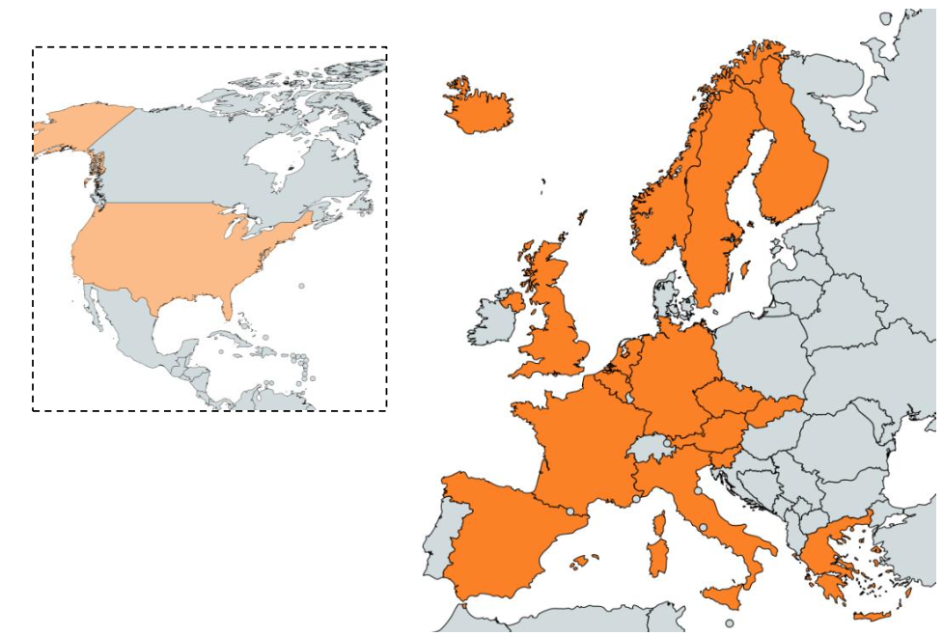
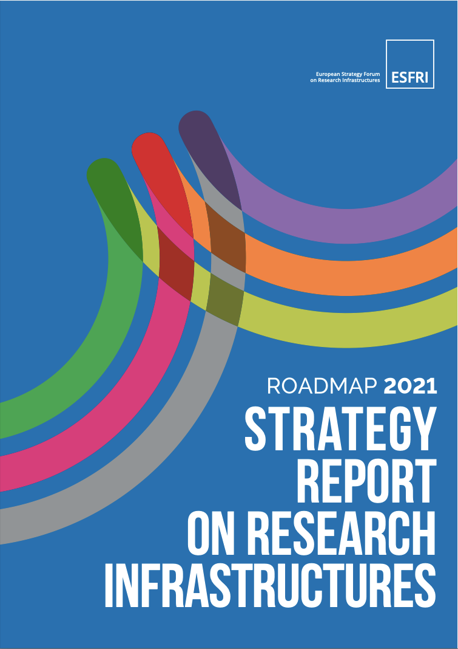
EIRENE RI - Environmental Exposure Assessment Research Infrastructure
Member states:
Austria
Belgium
Czech Republic
Finland
France
Germany
Greece
Iceland
Italy
Netherlands
Norway
Slovakia
Slovenia
Spain
Sweden
UK
USA
A gap identified in the Health&Food domain of 2018 ESFRI Roadmap
There is a need to enable a research infrastructure that will facilitate research on the human health and wellbeing at all stages in development, including ageing, nutrition and behavioural studies, and their connections to the social sciences and humanities.
The current development of the H&F RIs brings also a new inter- disciplinary RI the ESFRI Project EIRENE RI on the roadmap.
This RI fills the gap in the European infrastructural landscape and pioneers bridging the topic of environmental impact and human health with the topic of human exposome, i.e. environmental determinants of health.
17 national hubs, 50+ individual partners

Slide 13
Science to Policy and Society
RECETOX hosts National Centre for Toxic Compounds and Stockholm Convention Regional Centre for Capacity Building and the Transfer of Technology.
The National Centre links the research outputs and innovation potential of RECETOX to the needs of partners from government, authorities and private sector and identifies application opportunities in the field of environment and health in the Czech Republic.
The Stockholm Convention Regional Centre supports capacity building for chemicals management and global monitoring and information systems of toxic chemicals. It is also partner of choice for United Nations organizations UNEP, WHO, UNIDO, UNDP.
From 2023, RECETOX is the WHO Collaboration Centre in the area of effects of toxic substances on the environment and human health
Activities related to Basel, Rotterdam and Minamata Convention on Mercury.

Slide 14
Brno Living Lab
The Brno Living Lab concept was introduced in cooperation with the City of Brno, South Moravian Authority, and citizens participating in our research projects.
Brno Living Lab is a platform for improved communication and data sharing between scientists, policymakers, citizens, and other regional stakeholders and open to multiple MU research teams and external users.

Slide 15
RECETOX in 2024
28
EU framework projects
54 new colleagues
11 countries
293 employees
160 women
61 project application submitted (22 to HEU)
min. 15 projects granted
7 new started in 2024
c. 80 research projects running in total
> 176
100 new bsc students
31 new master students
9 new PhD students
11 PhD graduated
3 core facilities
18 000 analyses
60% external users
ESFRI EIRENE RI development
publications
80% in Q1
17% in TOP5%

Slide 16
RECETOX Masaryk University Kamenice 753/5, pavilion A29 625 00 Brno Czech Republic
info@recetox.muni.cz
recetox.muni.cz

